Slide 1
Effects of Gesture on Intonation in Clarinet Recordings MUMT620 Assignment 2
Lucas March

Slide 2

Overview
01
Introduction
02
Methods
03
Results
04
Conclusions

Slide 3
Introduction

Slide 4
Purpose
This project aims to explore the impact of gestures on intonation in clarinet performance
Objectives:
To identify and categorize gestures commonly associated with clarinet playing.
To analyze the influence of these gestures on intonation during clarinet performance.

Slide 5
Ancillary Gestures in Music Performance
Fundamental and consistent element in musical performance⁸
Strongly influence the expression of the music
Correlation between movements and music⁷
Expert clarinet players exhibit strong correlations in movements across different performances of the same piece.
Suggests a link between what is played and how it's played.
Ancillary gestures are not random but integral to the performance.

Slide 6
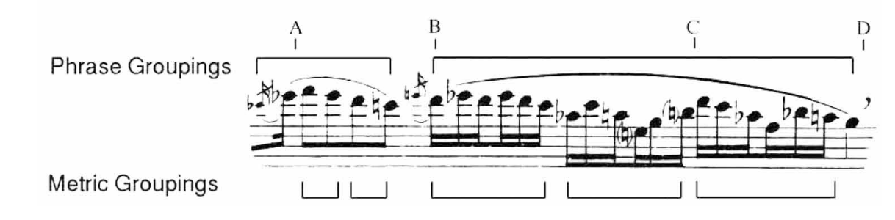
Ancillary Gestures in Music Performance
Examined clarinetists' expressive gestures in three performance styles: immobile, standard, and expressive.⁸
Immobilized performances were faster, shorter in duration.
Ancillary gestures related to note groupings: equal-duration clusters and phrasing.
Varied body regions used for gestures: knees, waist-bending, etc.

Slide 7
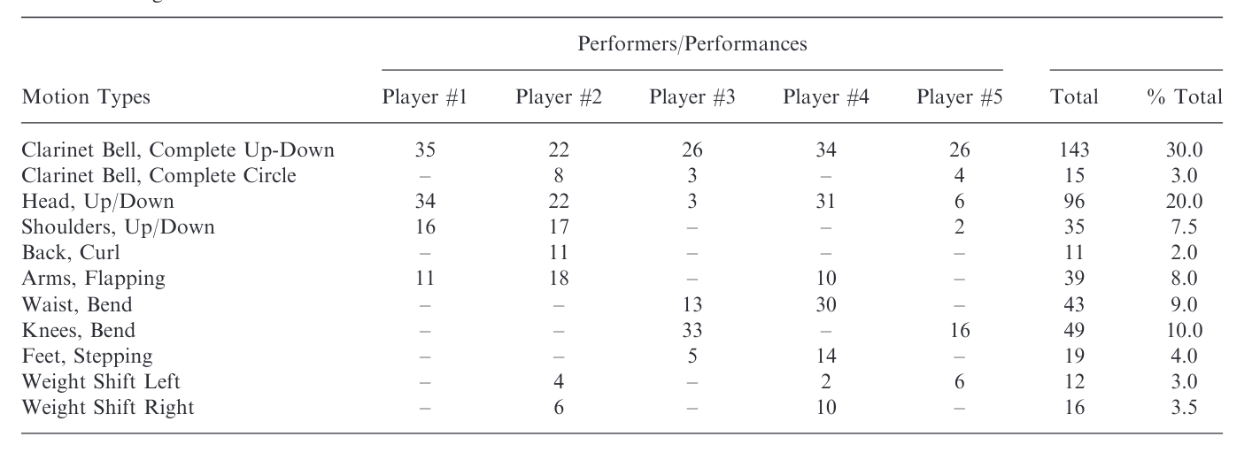
Motion Types

Slide 8
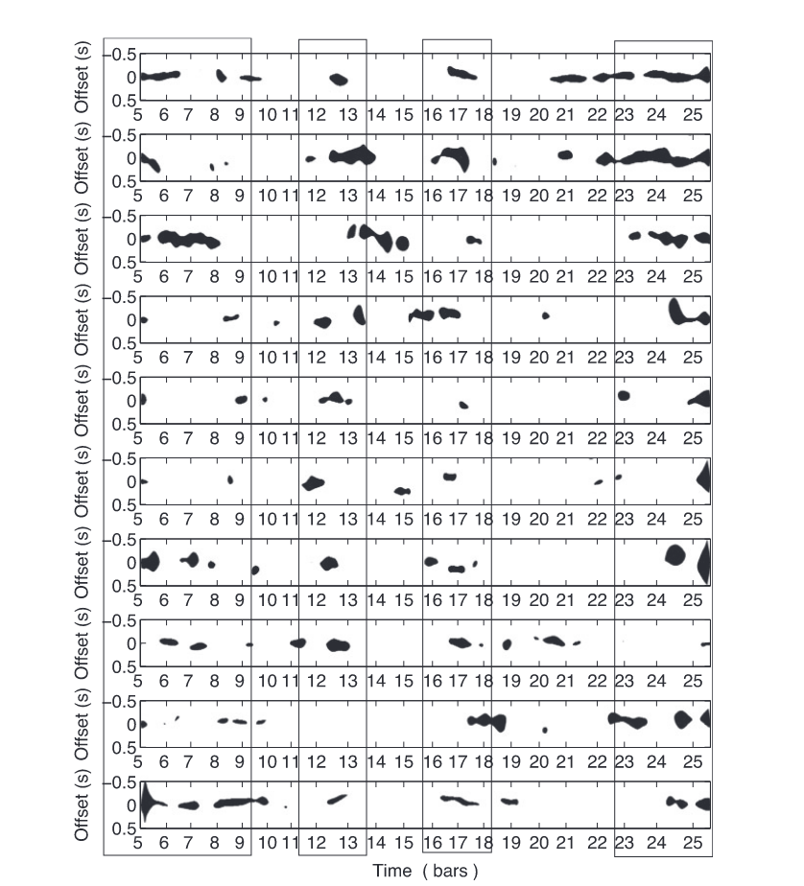
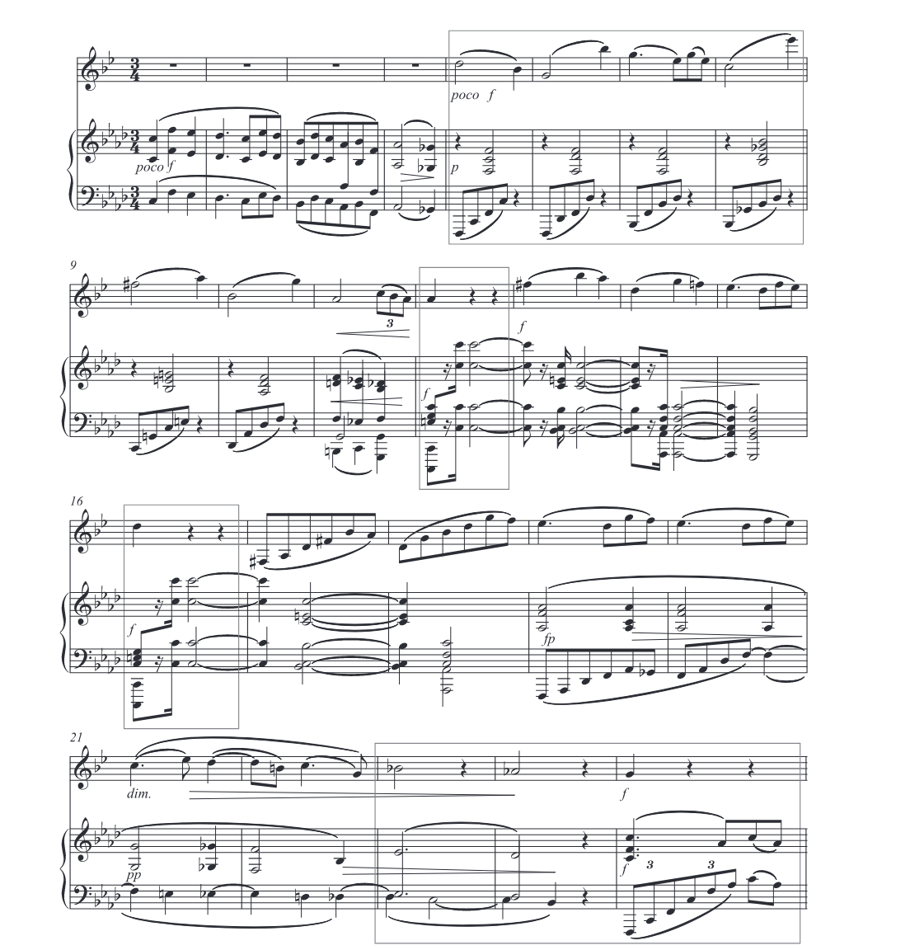
Motion Recurrence
Represented, segmented, and analyzed patterns or recurrence on motion data during musical performances⁶

Slide 9
Intonation
Defined as “accuracy of pitch in playing or singing” or “the act of singing or playing in tune”²

Slide 10
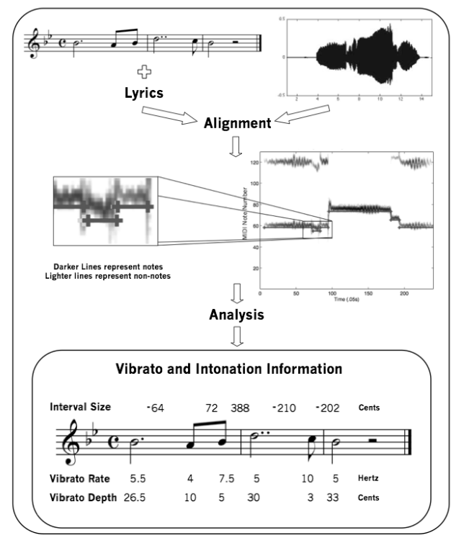
Intonation
AMPACT analyzes monophonic performance data.³
Utilizes score (MIDI) information to estimate note onsets and offsets.¹
Extracts performance parameters such as inter-onset intervals, tempo, dynamic levels, mean frequency, interval sizes, and vibrato characteristics.
Enables statistical comparisons of different performances of the same musical material.

Slide 11
Methods

Slide 12
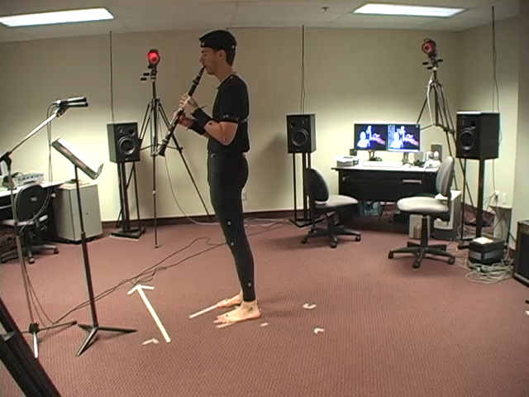
Dataset
8 videos
5 standing
3 seated
5 performers

Slide 13
Fundamental Frequency Estimation
Algorithm
pYIN: A modification of the widely-used YIN algorithm for fundamental frequency (F0) estimation.⁴
Stage 1
Outputs multiple pitch candidates with associated probabilities.
Probabilities derived from a prior distribution on YIN's threshold parameter.
Stage 2
Utilizes a hidden Markov model and Viterbi decoding
Enhances the pitch track based on probabilities.

Slide 14
Methods
Spectrogram Calculation
using librosa's Short-Time Fourier Transform (STFT) method⁵
Extract pitch candidates and magnitudes using pYIN
Pitch Extraction and Analysis
Iteratively determine the dominant pitch for each time frame
Determine tuning deviations over time, producing a sequence of deviations for each time step.
Calculate pitch-related statistics: mean, standard deviation

Slide 15
Pitch Tuning
librosa.pitch_tuning is used to estimate the tuning offset of a collection of detected pitches relative to a reference pitch⁵
Returns the estimated tuning deviation, expressed as fractions of a frequency bin
Tuning Deviation: Tuning deviation measures how detected frequencies differ from a reference pitch
Fractions of a Bin: Tuning deviation is expressed as a fraction of the size of one frequency bin. (e.g., 0.01, which corresponds to cents).
Interpretation: A value like -0.25 means detected frequencies are approximately a quarter of a bin lower in pitch than the reference.

Slide 16
Visualization
Interval Splitting
Determine interval duration
Extracts the tuning deviations within that interval.
Box Plot
display the distribution of tuning deviations in each time interval
Line Plot
shows the average tuning deviation over time intervals

Slide 17
Results

Slide 18
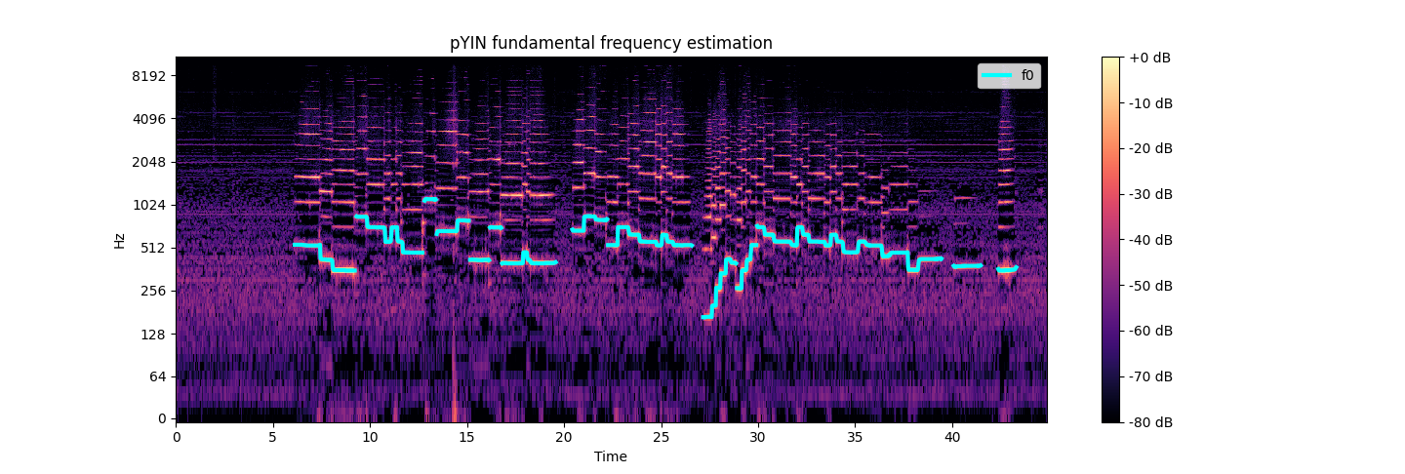
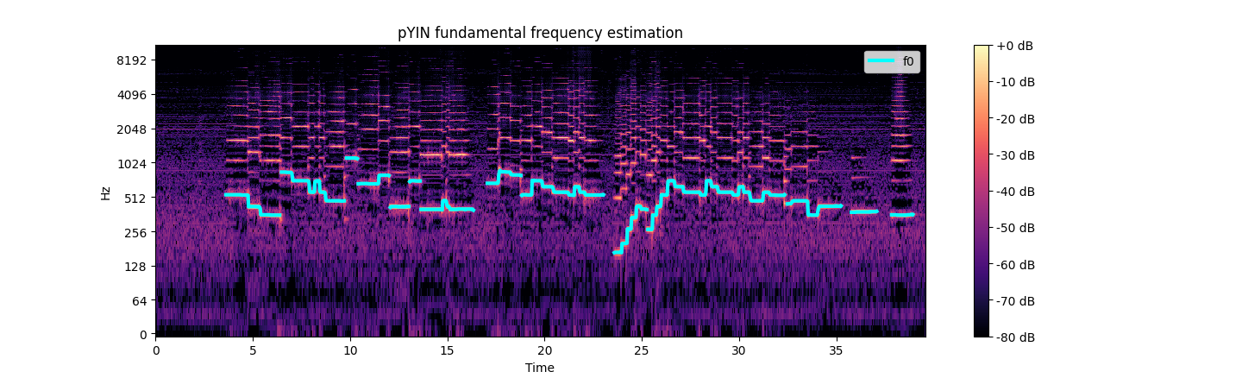
Standing
Seated

Slide 19
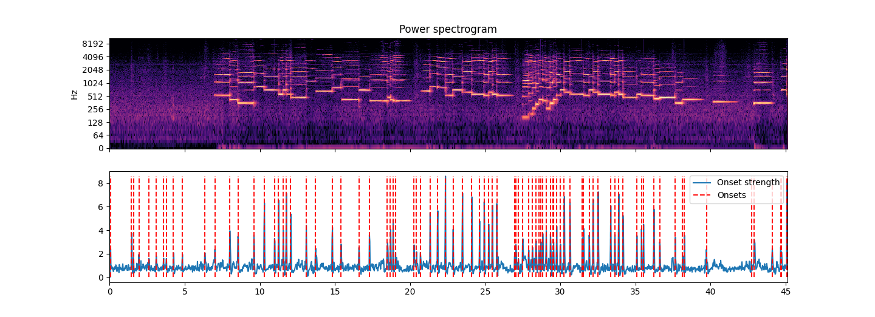

Slide 20
Performer | Seated (0) Standing (1) | mean_deviation (cents) | std_deviation (cents)
1 | 0 | 11.7 | 17.0
2 | 0 | 12.0 | 13.9
3 | 0 | 20.6 | 19.0
1 | 1 | 11.0 | 18.7
2 | 1 | 9.10 | 12.7
3 | 1 | 15.7 | 18.5
4 | 1 | 17.7 | 14.9
5 | 1 | 11.7 | 14.8
Avg (seated, mean_deviation) = 14.8
Avg (standing, mean_deviation) = 13.0
Avg (seated, std_deviation) = 16.6
Avg (standing, std_deviation) = 15.92

Slide 21
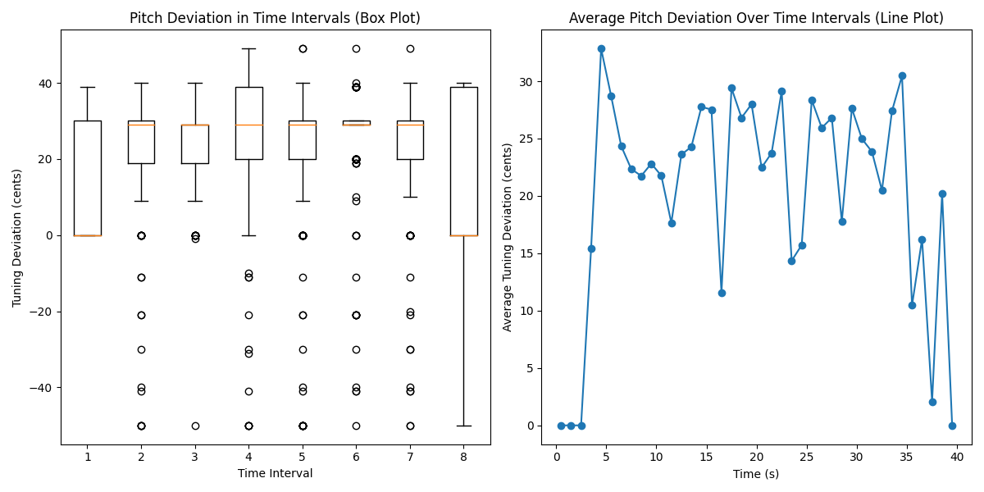
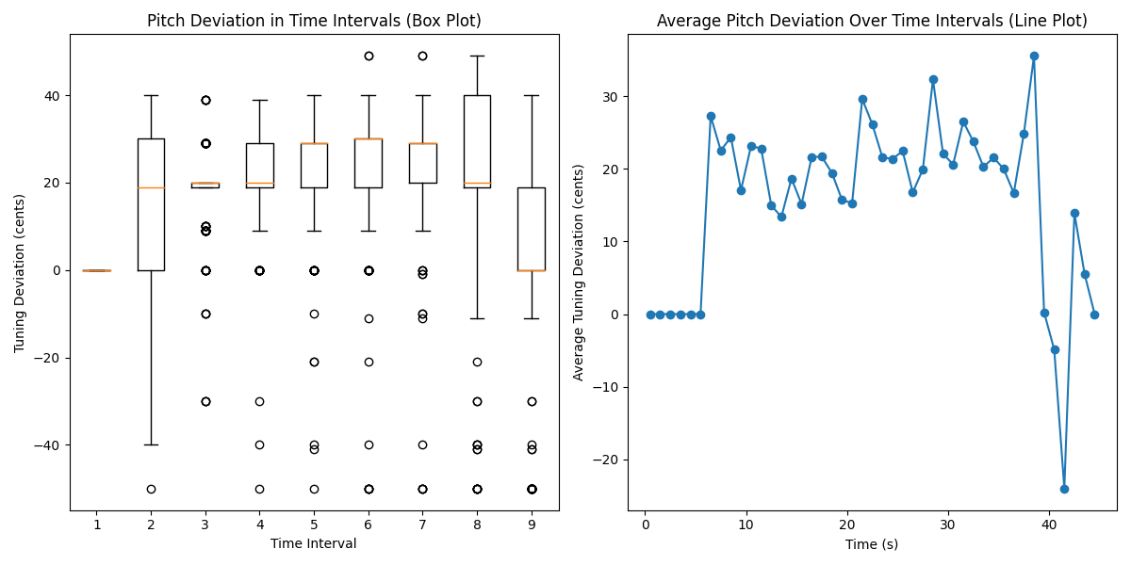
Pitch Tuning Deviation
Seated
Standing

Slide 22
Seated
Standing

Slide 23
Limitations / Future Work
Dataset
Size
Fixed position
Use MIDI informed pipeline to improve reliability
Further exploration of specific gestures

Slide 24
Conclusions
Playing while standing (i.e., more expressive position) allowed for better intonation
Posture, breathing
Ancillary gestures are integral to the music performance
Music is embodied, with physical expressions playing a crucial role in musical outcomes.

Slide 25
References
Schwär, Simon J., Sebastian Rosenzweig, and Meinard Müller. "A Differentiable Cost Measure for Intonation Processing in Polyphonic Music." In ISMIR, pp. 626-633. 2021.
Dai, Jiajie, Matthias Mauch, and Simon Dixon. "Analysis of intonation trajectories in solo singing." In Proceedings of the 16th ISMIR Conference, vol. 421, p. 29. 2015.
Devaney, Johanna, Michael I. Mandel, and Ichiro Fujinaga. “A Study of Intonation in Three-Part Singing Using the Automatic Music Performance Analysis and Comparison Toolkit (AMPACT).” In ISMIR, 511–16. Citeseer, 2012. https://citeseerx.ist.psu.edu/document?repid=rep1&type=pdf&doi=0083e2861d97841e0a27e22c12834053d7259c23.
Mauch, Matthias, and Simon Dixon. “PYIN: A Fundamental Frequency Estimator Using Probabilistic Threshold Distributions.” In 2014 IEEE International Conference on Acoustics, Speech and Signal Processing (ICASSP), 659–63. Florence, Italy: IEEE, 2014. https://doi.org/10.1109/ICASSP.2014.6853678.
McFee, Brian, Colin Raffel, Dawen Liang, Daniel Ellis, Matt McVicar, Eric Battenberg, and Oriol Nieto. “Librosa: Audio and Music Signal Analysis in Python,” 18–24. Austin, Texas, 2015. https://doi.org/10.25080/Majora-7b98e3ed-003.
Teixeira, Euler C.F., Mauricio A. Loureiro, Marcelo M. Wanderley, and Hani C. Yehia. “Motion Analysis of Clarinet Performers.” Journal of New Music Research 44, no. 2 (April 3, 2015): 97–111. https://doi.org/10.1080/09298215.2014.925939.
Wanderley, Marcelo M. “Quantitative Analysis of Non-Obvious Performer Gestures.” In Gesture and Sign Language in Human-Computer Interaction, edited by Ipke Wachsmuth and Timo Sowa, 241–53. Lecture Notes in Computer Science. Berlin, Heidelberg: Springer, 2002. https://doi.org/10.1007/3-540-47873-6_26.
Wanderley, Marcelo M, Bradley W Vines, Neil Middleton, Cory McKay, and Wesley Hatch. “The Musical Significance of Clarinetists’ Ancillary Gestures: An Exploration of the Field.” Journal of New Music Research 34, no. 1 (March 1, 2005): 97–113. https://doi.org/10.1080/09298210500124208.

